Slide 1
UnipolTech
Using data to plan urban mobility
September 2024

Slide 2




UnipolTech is a 360-degree mobility partner
Mln
Ongoing contibution to The Urban Mobility Council
GNSS observation from cars in italy
Mln
Raised motorway barriers
UnipolTech can help Public Administration to evaluate sustainable mobility policies consistent with economic challenges and to have the correct balance between environmental progress and well-being through a scientific approach

Slide 3
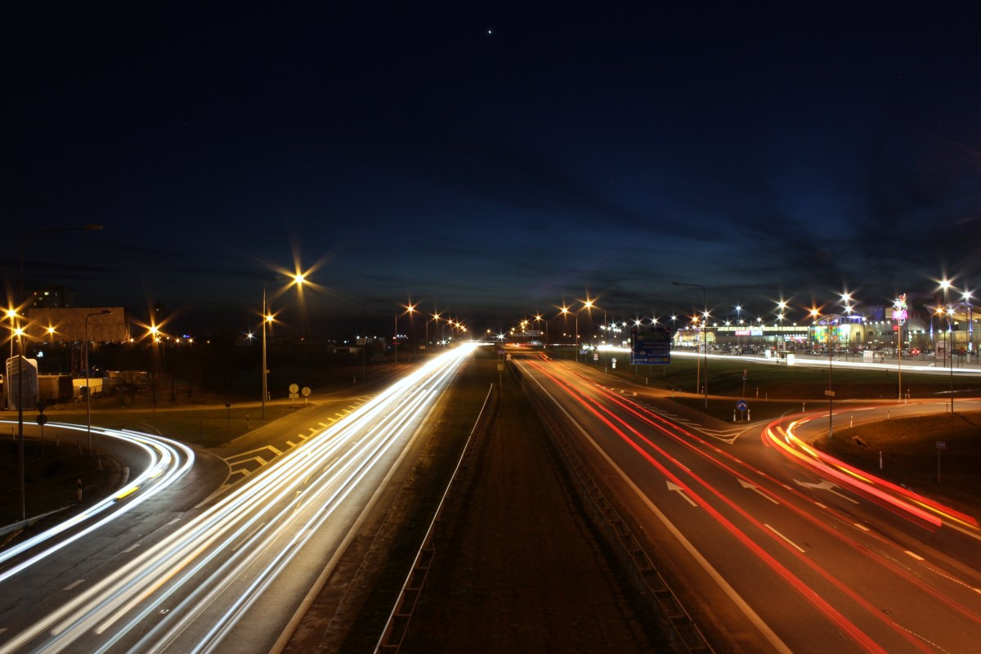









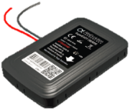


UnipolTech is Unipol Group's center of excellence and leader in telematics and electronic tolling
TELEMATICS
ELECTRONIC TOLL AND MOBILITY SERVICES
Key numbers
4+ million
active black boxes at the end of 2023
A thirty-year monopoly interrupted in 2022 with the introduction of the "UnipolMove" electronic toll device
Group center of excellence on telematics, IoT and Big Data
190.000+
managed claims per year at the end of 2023
Leader in insurance telematics applied to vehicles in Italy (where it holds a share of approximately 60%) and in Europe
Activated Mobility services such as structure parking, roadside parking, payment of fines, road tax, fuel and Milan “Area C”
€220+ million
value of transaction at the end of 2023
Telematics devices, patented algorithms and UBI services for fleets
140+ million
raised motorway barriers
Experimental Mobility-as-a-Service (MaaS) app launched with public transport, taxis, micromobility and short-term rental
1,6 million
electronic toll devices in mid-2024

Slide 4





UnipolTech boxes generate large quantities of data that can be used for different purposes
Crash reconstruction
4+ Mln
black-box
Vehicle search in case of theft
Assistance requests via private eCall
Analysis of customers' driving style to provide recommendations aimed at reducing fuel consumption
25 Bln Km
every year
Analysis of traffic flows to provide valuable information to both public and private players (e.g., transits near points of interest, identification of dangerous intersections, urban planning)
These data can enable a
wide range of services:
Measurement and control of vehicles environmental impact and support in managing the ecological transition
…

Slide 5








The strategic value of UnipolTech makes it a point of reference for technology and data
Focus next slides
Involved with associations, public entities and organizations that operate and focus on issues functional to UnipolTech's core business
Promotes research and talent scouting thanks to an Open Innovation Network of universities
Not exhaustive
The Urban Mobility Council is a permanent platform for discussion, brainstorming and research, in order to stimulate reflection on new forms of mobility
Università
di Bologna
Boston’s
MIT
Politecnico
di Milano
Open Innovation Network
Politecnico
di Torino
The themes of the year are:
Green box
Safe cities
Federico II
di Napoli
Politecnico
di Bari

Slide 6
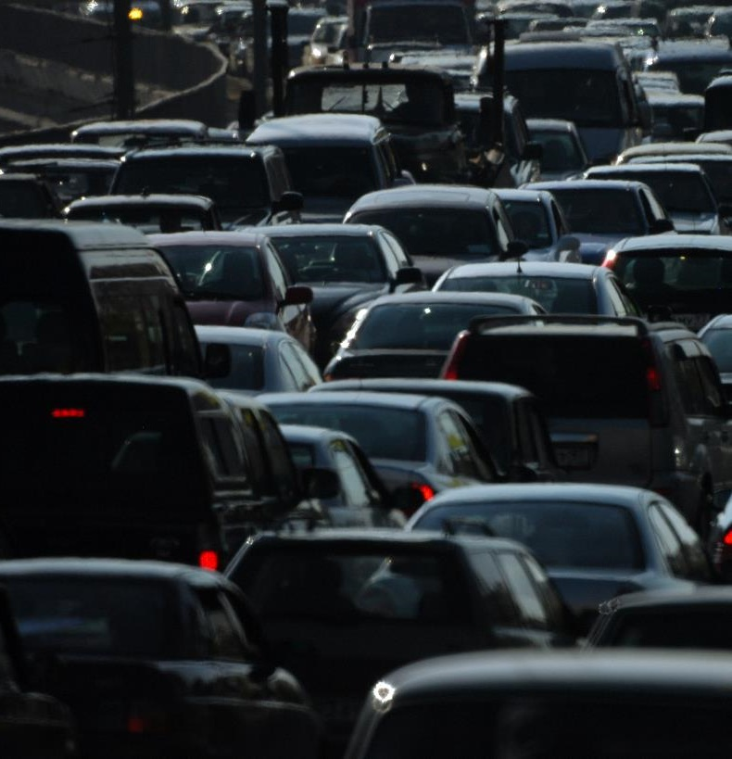
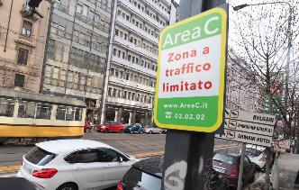

The Urban Mobility Council | Green box
Using data generated by UnipolTech boxes and academic studies on CO₂ and NO_{x} emissions we found that the polluting class and the number of km are not sufficient to measure actual pollution
Today the most virtuous municipalities started to allow access to downtowns based not only on the polluting class, but also by limiting the kilometers traveled by vehicles with the most critical polluting classes (MoVe-In)
Key elements for measuring actual pollution are also:
Average speed
Driving style
If the speed is too high or too low, the emissions per km are higher
An aggressive driving style increases emissions
Using AS IS telematic boxes, UnipolTech is able to provide municipalities with this information, transforming "black boxes" into "green boxes" and making sustainability measures more effective

Slide 7






The Urban Mobility Council | Safe cities
With the aim of making cities more safe, livable and less noisy, many cities in Europe (e.g. Brussels, Amsterdam, London, Madrid, Barcelona) have substantially increased the number of roads with a
30 km/h speed limit
Analysis results
Minimum impact on:
Travel times
Emissions
(vehicles today)
In this regard, UnipolTech and Boston’s MIT have established a partnership to study the impact of Zone 30 in Milan
Further analyzes are underway to understand the impacts on safety

Slide 8
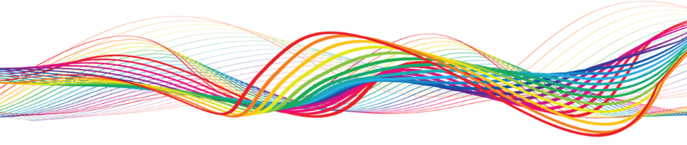





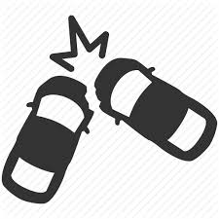
Urban mobility studies for the Municipality of Trento | Available data and ongoing studies
UnipolTech has access to a vast amount of data, which are used in
two studies for the Municipality of Trento
~5k vehicle in transit daily
Speeds study
Average speeds in the different road sections
>100.000 km tracked every day, also distinguished by road type
Driving style study
~50 claims per month with relative geolocation
Roads where sudden braking/ acceleration events are concentrated
Driving style

Slide 9
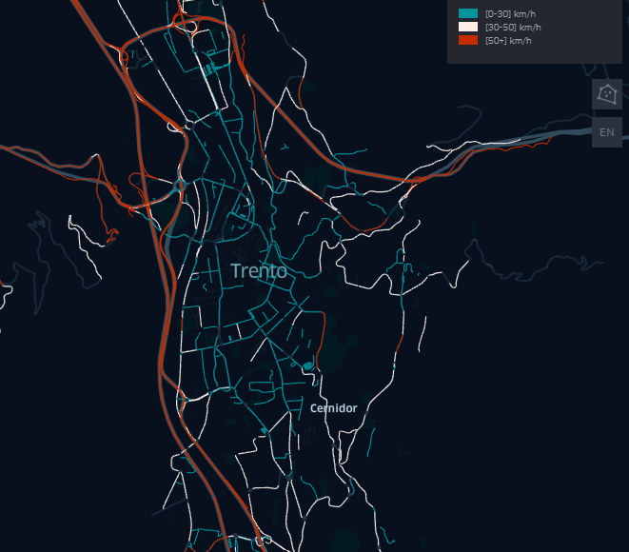
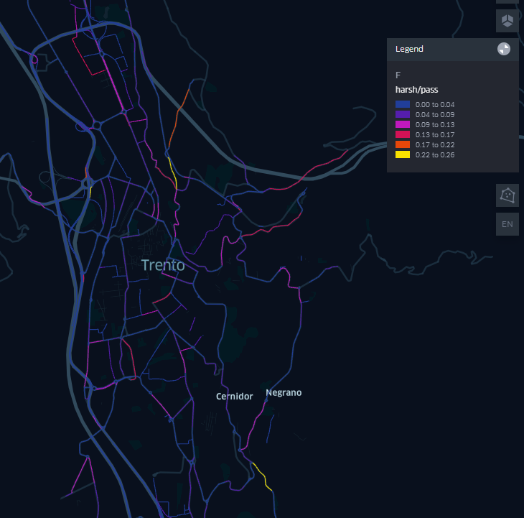
Urban mobility studies for the Municipality of Trento | First evidences
Speeds study
Driving style study
Low-flow urban roads with an average speed already recorded within 30km/h. It will be possible to monitor specific road arches based on the Municipality's considerations (e.g. proximity to schools, hospitals)
Low concentration of braking events in specific points of the ring road (e.g. ramps, roundabouts) and in some segments of the road network (yellow-orange on the map) which could represent a phenomenon requiring further investigation

