Slide 1

Systemic inequalities in road safety outcomes across high income countries and lessons from intervention approaches
Nicola Christie
Professor of Transport Safety
UCL

Slide 2

What we did
Narrative review
Literature searches, over the last 15 years
Reviewed 42 sources after applying exclusion criteria.
Strategic review to understand what we know and where the gaps are
https://doi.org/10.1016/j.jth.2025.102006

Slide 3
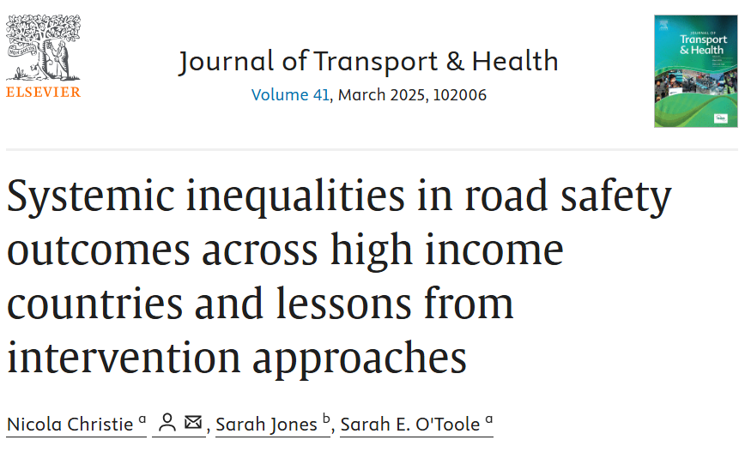
Funded by the UK Road Safety Trust https://www.roadsafetytrust.org.uk/

Slide 4
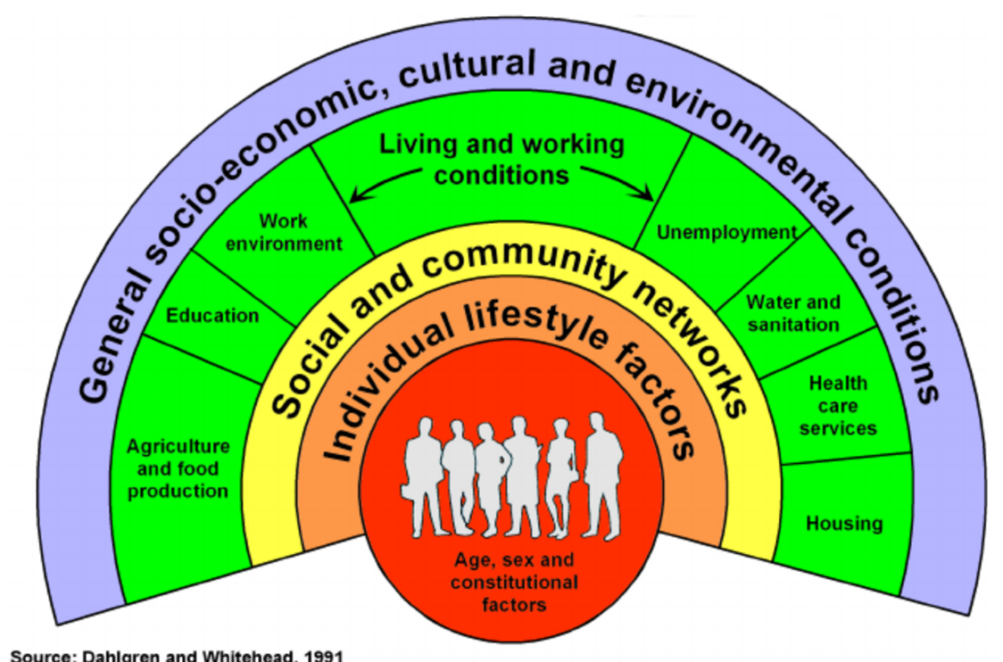
Introduction
Road safety outcomes show a clear socioeconomic gradient
Inequalities stem from broader social and environmental factors
A "wider determinants" approach addresses root causes through cross-sector collaboration.

Slide 5
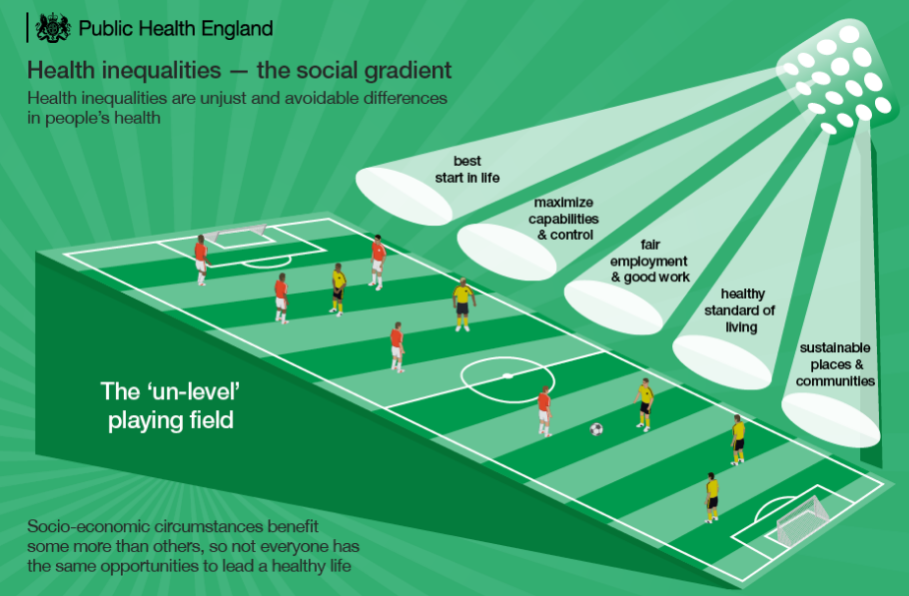
Estimates of inequalities in road safety outcomes
GB – pedestrians around 3-4 times more likely to be killed or seriously injured in the most deprived vs. least deprived area
This relationship persists even taking exposure into account (kms walking, cycling, in cars etc)
Evidence that the gap is widening
Trend is seen across all modes

Slide 6
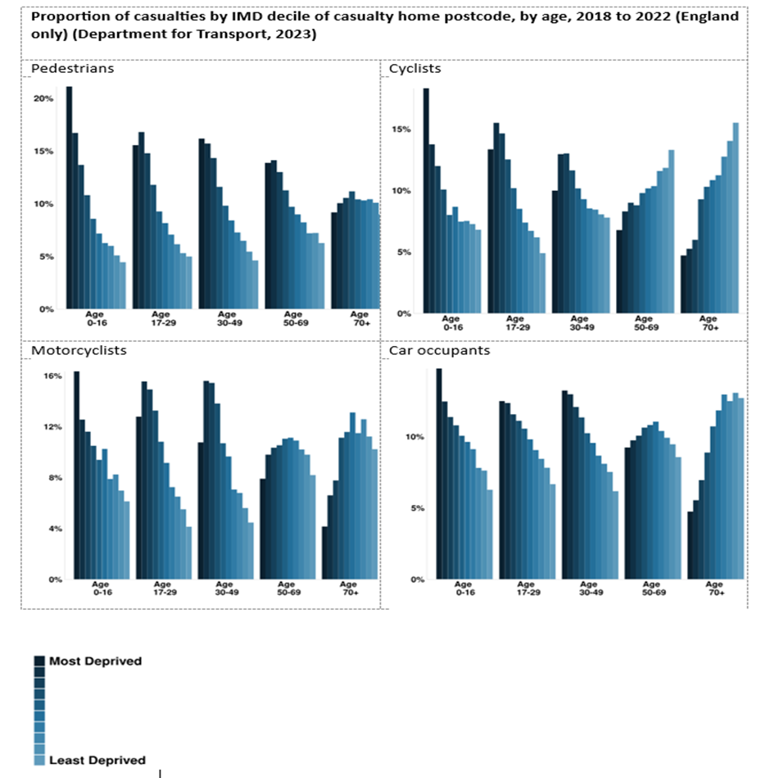
Darker the blue =more deprived)

Slide 7
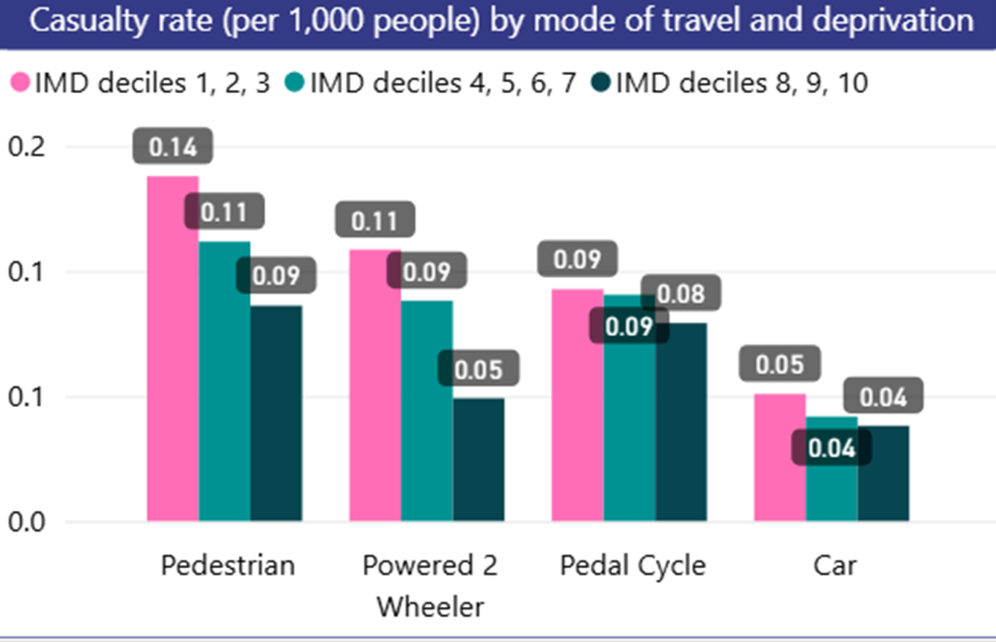
How do we know we have a problem?
Mapping killed and seriously casualties by level of deprivation census data
Indices of multiple deprivation - most developed countries have these e.g Italy Indice di Deprivazione but few explore road collisions by deprivation
Done at a national level and local level
Transport for London has developed an innovative interactive dashboard https://app.powerbi.com/view?r=eyJrIjoiMDM2OWYyYzgtMzM1Ny00NGFmLThlY2EtM2NmZWVhZTZmYjFkIiwidCI6IjFmYmQ2NWJmLTVkZWYtNGVlYS1hNjkyLWEwODljMjU1MzQ2YiIsImMiOjh9

Slide 8

Overall findings
Focus on risk factors
Quantitative approaches
Little data on interventions
Limited intervention evaluation evidence

Slide 9
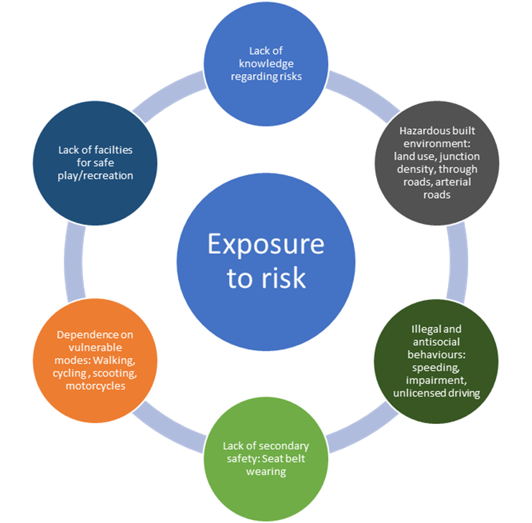

Slide 10
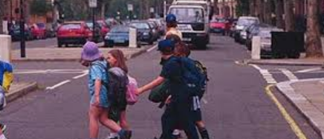
Young Road Users
Deprivation increases risk, especially for young pedestrians and cyclists, even after adjusting for exposure.
UK data shows rising rates in deprived areas; children in these areas face double the death rate.
Studies in Canada and New Zealand confirm similar patterns.

Slide 11
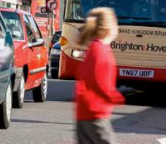
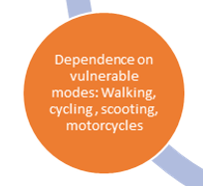

Poverty does not cause collisions exposure to road traffic does

Slide 12
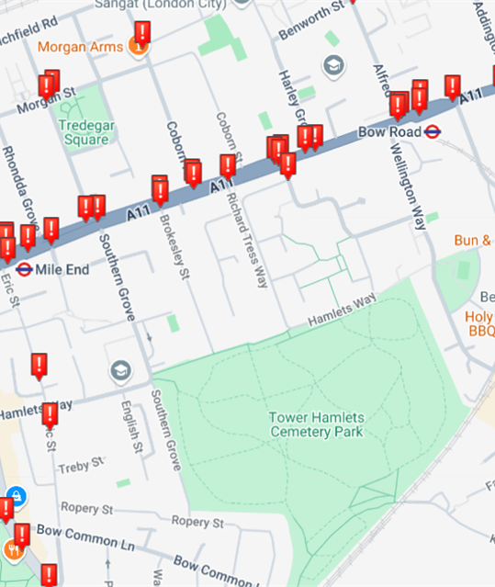
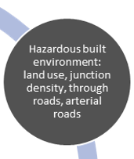
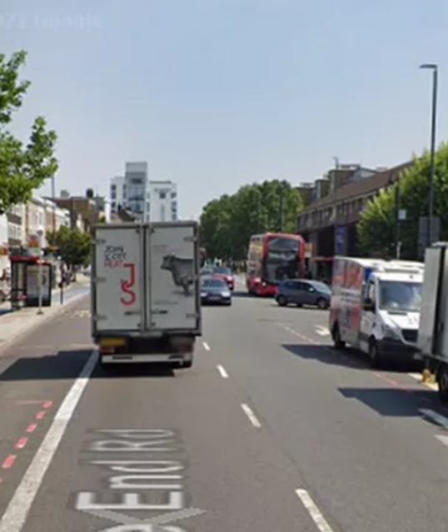
Hazardous environments
Higher traffic flows and speeds, complex road layouts in poor areas increase injury risk.

Slide 13
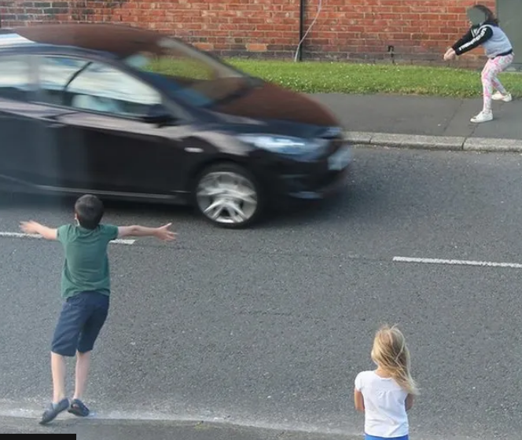
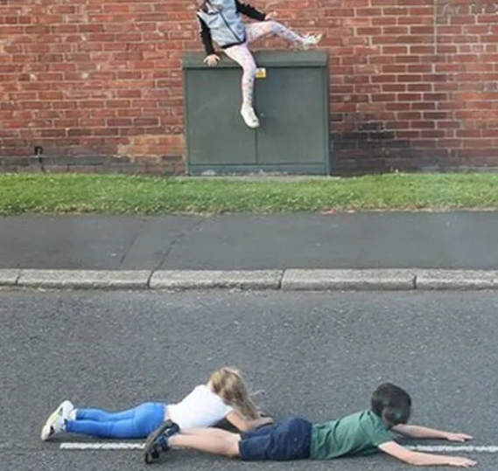
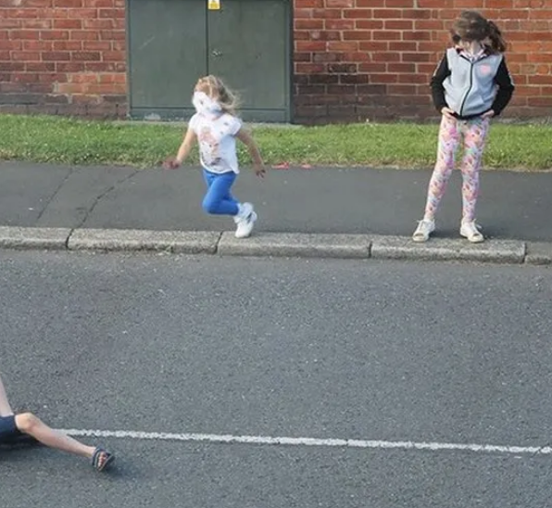
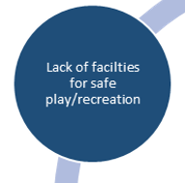
The road is used for play and recreation
E.g. children may play in the street because they live in overcrowded housing and there is no safe place to play

Slide 14
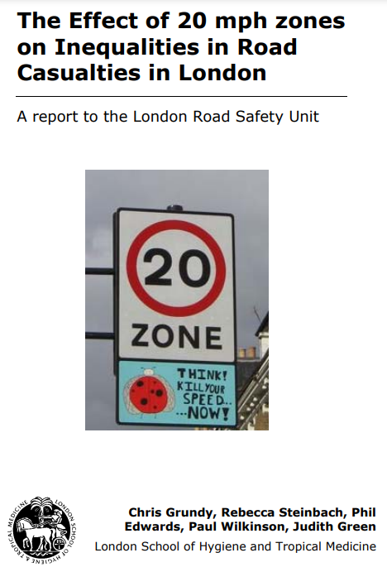
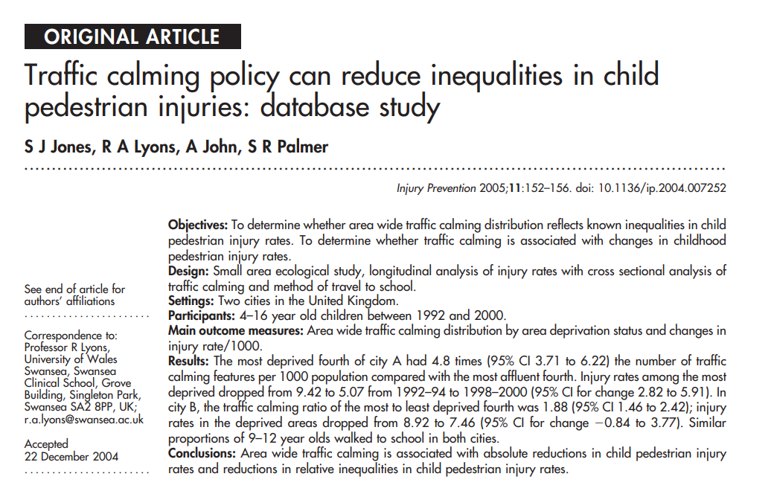
Intervention approaches
Good evidence that area-based engineering approaches that restrict speed and flow of traffic have reduced inequalities

Slide 15
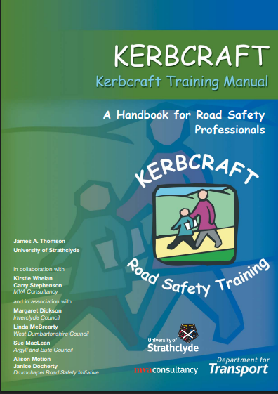
Child Pedestrian Training
Randomized controlled trial of Kerbcraft pedestrian training programme showed improved children’s road-crossing skills in deprived areas among the intervention group
Success depended on school support and skilled coordinators.
https://www.roadsafetywales.org.uk/media/1048/kerbcraft20manualfinallores.pdf

Slide 16
Parent Education
Targeted programmes improved safety behaviours in low-income families.
More research is needed on engaging at-risk parents.

Slide 17
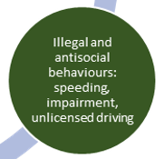
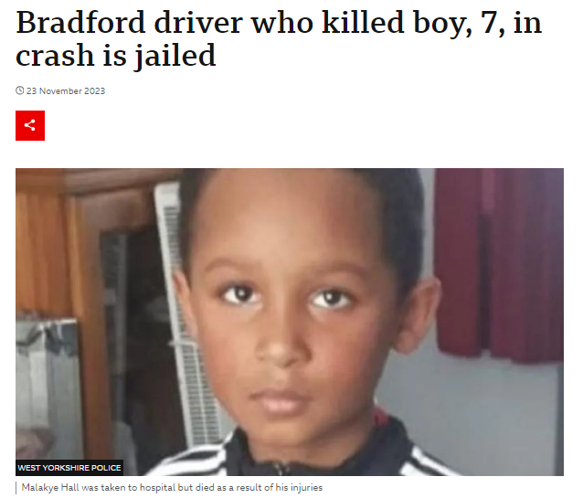
Unlicensed and uninsured drivers
Unlicensed driver
Twice legal limit of cannabis
Speeding
Drove the wrong way around a roundabout
Went through red lights
Driving around 50 mph went he hit the child

Slide 18
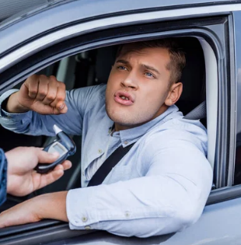
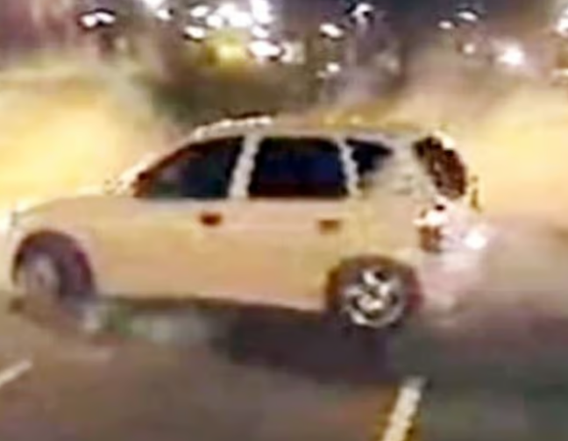
Illegal & Antisocial Driving and vehicle use
Deprived areas see more unlicensed, uninsured, and intoxicated drivers.
Risky driving behaviours are more common among young people in these areas.
Strong link with crime levels in deprived neighbourhoods
Lack of seat belt wearing

Slide 19

What’s the intervention approach ?
No evidence for interventions
  Understand the barriers and facilitators to legal driving?
  Enforce – more traffic police?
  Seize vehicle?
  Educate?
  Subsidise learning to drive?

Slide 20

Address barriers to licensing and insuring
Cost may be a barrier to legitimate driving
Driving lessons | £1575
Theory test | £23
Driving test | £62
A 20-year-old car average cost | £1800
Insurance for new young driver | £3000
Total cost | £6,460 (~7500 euros)

Slide 21

Multifaceted, Multiagency Approaches
Education alone is ineffective; strategies must address social determinants.
UK’s Neighbourhood Road Safety Initiative combined engineering, education, and enforcement showed casualty reduction https://discovery.ucl.ac.uk/id/eprint/1507918/1/nationalroadsafetyinitiativenc.pdf
Community involvement and cross-sector collaboration were key to success.

Slide 22
Overall strategic gaps in evidence
Risk factors are based on high level analysis
Need a more nuanced understanding of what is going on – the ‘Why?’
Lack of evaluated intervention approaches

Slide 23
Gaps: Children as vulnerable road users
How can we better understand behaviour:
What are children doing at the time of the collision and what are the behaviours of the involved driver ?
What are the specific vulnerabilities e.g. Special Educational Needs, new immigrants, refugees and asylum seekers?

Slide 24

Gaps: The built environment
How can we reduce the risks posed by:
Arterial roads?
Through traffic, and high junction density?
Lack of safe places to play ?
Lack of pedestrian and cycling infrastructure?

Slide 25

Gaps: Illegal and antisocial behaviours
How can we understand criminal and antisocial use of vehicles:
What are the characteristics of drivers or motorcyclists who injure or kill themselves or others?
What are the barriers and facilitators to legal and safe driving?
Why are there low levels of seat belt wearing?

Slide 26
Conclusions
Most research focuses on risk factors, not interventions.
Deprived areas face multiple, overlapping risks: hazardous environments, antisocial driving, lack of safe spaces.
More routine data collection and qualitative research are needed to understand the ‘why’
A systems approach involving all stakeholders is essential.
Participatory research and social marketing can improve intervention design.

Slide 27
Policy & Practice Recommendations
Use population-wide, proportionate interventions to avoid marginalisation.
Address wider determinants like housing and play space access.
Promote behaviour change through multiagency collaboration.
Communicate changes clearly and involve communities in planning.
Recognise that some solutions lie outside traditional road safety (e.g., urban planning).
Frame road safety as part of broader health and sustainability goals.
Prioritise system-wide interventions for young pedestrians, cyclists, and car occupants.
Governments must collect and use deprivation-linked road safety data.

Slide 28
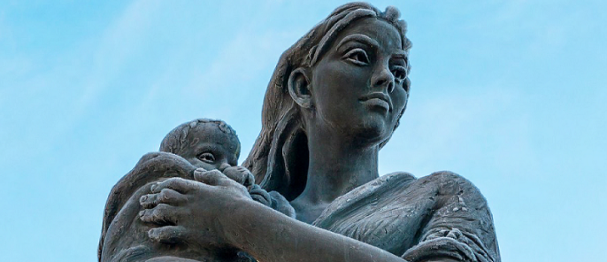
New UCL project may answer some of these questions
In depth ‘wider determinants’ analysis of all road fatalities involving people under 18 using National Child Mortality Database 2019-2024
Includes:
  Multi agency review of each case
  Police fatal file
  Post-mortem
  Emergency services report
  Social services report
https://www.ncmd.info/publications/report-child-accident-injury/

Slide 29
Thank you!
Any questions
Please contact me
Nicola.christie@ucl.ac.uk

