Slide 1

Tackling transport poverty and inequalities in access to mobility
The contribution of the Social Climate Fund
Daniel WOEHL
Head of unit – Finland, Latvia, Estonia Lithuania
Directorate-General for Employment, Social Affairs and Inclusion
Directorate D – Social Rights and Inclusion

Slide 2

Framework: transport poverty
Main concept for tackling inequality and inclusion issues in mobility.
“Three As” definition: Availability, Accessibility, and Affordability.
Falls under principle 20 of the European Pillar of Social Rights: right to access essential services of good quality.
Complex issue, not measurable with one indicator. Key conclusions of the Commission’s Transport Poverty study include:
  Not exclusively a rural phenomenon but greater issues in rural areas.
  Particularly affects vulnerable populations.
  Greatest impact: measures supporting low- and lower-middle income households in underserved geographical areas, focus on the most vulnerable and on improvements to public transport and shared mobility.
See also: Commission Recommendations on Transport Poverty (2025/1021)

Slide 3

The Social Climate Fund
Current policies insufficient to reach EU’s 2030 climate target.
Emission Trading System (ETS)2: carbon pricing scheme complementing ETS1 by expanding coverage to buildings and road transport, various small industry sectors. Becoming fully operational in 2027.
New Fund to mitigate the social impact of ETS2 on vulnerable households, transport users, and micro-enterprises.​
  Two components: buildings (energy efficiency) and transport.​
Financed by auction revenue from ETS2 (+25% national co-financing).​
  SCF will mobilise at least EUR 86.7 billion over the 2026-2032 period.​
MS to submit a national Social Climate Plan (SCP) detailing investments, measures, and potentially reforms to be undertaken under the SCF.​
  Most MS are currently preparing their SCP. Public consultations are an essential component of SCP preparations.

Slide 4
Tackling transport poverty with the SCF
Core consideration of the SCF Regulation: first definition of transport poverty in EU legislation (Art 2):
  ‘transport poverty’ means individuals’ and households’ inability or difficulty to meet the costs of private or public transport, or their lack of or limited access to transport needed for their access to essential socioeconomic services and activities, taking into account the national and spatial context.
Approach is policy-based, and performance-based.
Highly targeted fund: measures and investments must clearly identify vulnerable transport users and “principally target” them (Art 8).
Best practices and guidelines emphasise shared and zero (or low) emission mobility.

Slide 5


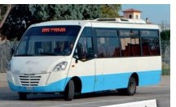
Proposed measures (1):
Transport on demand
Popular proposed measure in several MS.
Ensures mobility in remote (especially rural) areas with lacking public transport options.
Flexibility of on-demand system counteracts reduced demand due to low population density.
Especially useful for first-mile connectivity and to connect remote areas to existing networks.
Accessible alternative for vulnerable populations where individual mobility options not possible (e.g. due to cost, age, disability).

Slide 6

Proposed measures (2):
Inclusive micromobility
Proposals in several Member States to support micromobility.
  Focus on helping vulnerable transport users purchase or lease bicycles (including electric).
Usually accompanied with development of safe and dedicated micromobility infrastructure.
  Especially in areas with high proportions of vulnerable transport users.
  Construction of new bicycle lanes but also e.g. bicycle shelters to support multimodal connections.
Also proposal for a dedicated investment for persons with reduced mobility.
  Provision of adapted technical aids to support the mobility of vulnerable persons, e.g. suiting various medical needs and disabilities.
  Essential to ensure an inclusive approach to reducing transport poverty.

Slide 7
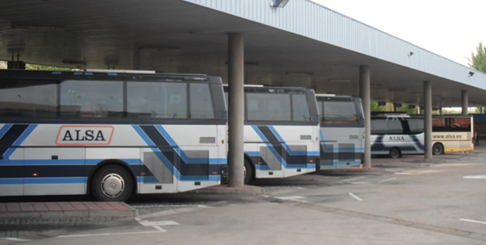
Proposed measures (3):
Support for regional public transport
Various approaches to supporting public transport networks.
  Common trend of maintaining or extending lines in remote, sparsely populated areas.
Challenge of low population density and demand in rural areas:
  Support foreseen to keep lines economically viable.
  Synergies between existing networks and more flexible transport on-demand.
Replacement of aging fleets, in particular of buses:
  Switch to zero (or low) emission vehicles to reduce ETS2 price impacts.
  Purchase of more appropriate vehicle types and sizes.

Slide 8
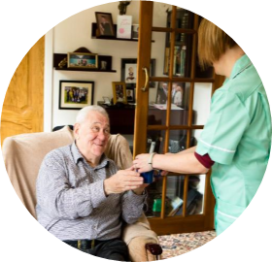
Proposed measures (4):
Social service mobility
Possibility of measures improving the mobility of healthcare and social service providers, e.g. purchase of electric vehicles.
Investment intended to enable providers to serve vulnerable transport users at home or close to home.
  Intended especially for remote areas with lacking public transport options.
  Improves accessibility for vulnerable people with more limited transport options, e.g. due to age or disability.

Slide 9
Thank you!
© European Union 2025
Unless otherwise noted the reuse of this presentation is authorised under the CC BY 4.0 license. For any use or reproduction of elements that are not owned by the EU, permission may need to be sought directly from the respective right holders.
9

